Slide 1
PHASE VOCODER
BY
SHASHANK SHANTAM(54)
SHRENIK NAMBIAR(61)
YASH NEMA(62)

Slide 2
WHAT IS A PHASE VOCODER
Phase vocoding is a form of synthesis by analysis in that a sound file is analyzed and is then resynthesized by the phase vocoder. The classic use of a phase vocoder is to stretch the original sound out in time without changing its original pitch. Other possible uses include compressing a sound in time without changing the original pitch or changing pitch without changing original time. Often a combination of the two (alterations of both pitch and time) is used

Slide 3
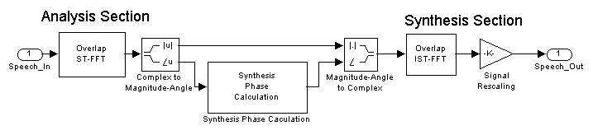

Slide 4
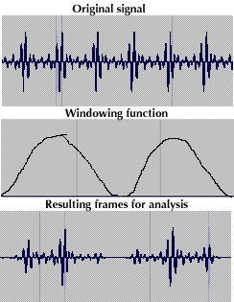
Analysis parameters
The first part of the process involves dividing a digital input signal into numerous time segments or blocks of samples and then multiplying those blocks by an envelope called a windowing function. The shape of these windows will have an effect on the weighting of the resultant analysis

Slide 5
Each window is then subjected to a form of spectral analysis called an STFT, or short-time Fourier transform. Each window is then subjected to a form of spectral analysis called an STFT, or short-time Fourier transform
The output of the FFT is comprised of two sets of values for each window called a frame. The first set of data provides the magnitude or amplitude of each component frequency analyzed. The second set of data provides the initial phase value for each frequency band of analysis. For each given frequency therefore, its amplitude at the time of analysis can be quantified and its phase, which gives clues as to where in that band's range the pitch may actually lie.
This sequence of operations of converting a signal to a combination of out-of-phase sinusoids is called heterodyning.

Slide 6
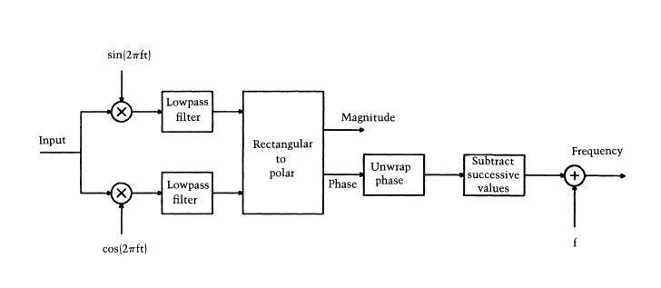

Slide 7
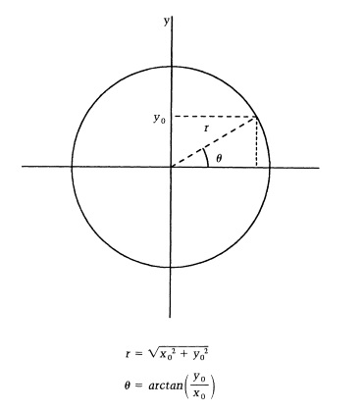

Slide 8
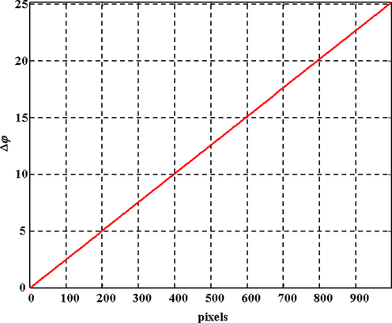
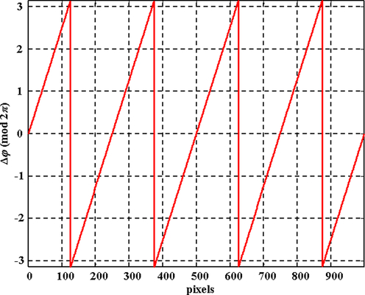
Need for phase unwrapping

